Slide 1

SOCIAL NETWORK DATA ANALYSIS
LeCTURE 5
CLUSTERING AND COMMUNITY DETECTION
Ilia Karpov (iakarpov@hse.ru)
Moscow, 2020

Slide 2
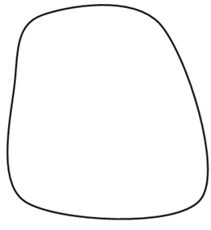
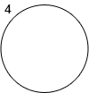
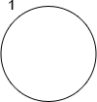
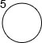
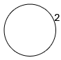
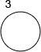
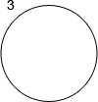
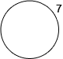
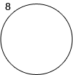
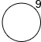
Iterative and Explorative search
Iterative search
Explorative search
R.W. White and R.A. Roth, “Exploratory Search: Beyond the Query-Response Paradigm”, 2009, pp. 1–98.

Slide 3
Введение
Методология зернового приращения акторов

Slide 4
Типовые отношения в социальных медиа
Actor 1 type | Actor 2 type | Tie type | description | direction
Public page | Public page | likes | 1 or 0 | directed
Public page | Public page | simultaneous likes | amount of users that simultaneously like the page | undirected
Public page | Public page | mutual posting | amount of users that simultaneously wrote post | undirected
Public page | Public page | mutual commenting | amount of users that simultaneously wrote comment to the page post | undirected
Public page | Public page | links | amount of mutual links | directed
Public page | Public page | subscribers intersection | amount of mutual subscribers | undirected
User | Public page | comments | total amount of comments | directed
User | Public page | likes | total amount of post likes | directed
User | Public page | subscribers | 1 or 0 | directed
Public page | User | likes | total amount of post likes | directed
User | User | friends | 1 or 0 | directed
User | User | links | amount of mutual links | directed
User | User | post likes | amount of user post likes | directed
User | User | comment likes | amount of user comment likes | directed
User | User | comment | amount of user post comments | directed
User | User | simultaneous comments | amount of users that simultaneously wrote post | undirected
User | User | Publications intersection | amount of that simultaneous comments to external posts | undirected
User | User | membership | amount of co-membership groups | undirected
User | User | joint subscription | amount of co-membership public pages | undirected
User | Group | membership | 1 or 0 | directed
User | Group | commenting | amount of comments | directed
User | Group | links | amount of links | directed
User | Group | reposts | amount of reposts from the group | directed
Group | Group | direct links | amount of links | directed
Group | Group | members intersection | members intersection | undirected
Group | Group | mutual commenting | amount of active users | undirected
Group | Public page | likes | amount of likes | directed
Public page | Group | likes | amount of likes | directed
Group | Public page | links | amount of links | directed
Public page | Group | links | amount of links | directed

Slide 5
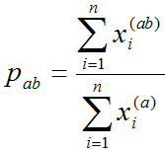
Введение
Ранжирование акторов
- связи между акторами в матрице (а)
- пересечение связей между акторами в матрицах (а) и (b)

Slide 6
Анализ силы различных связей в социальных медиа
Group - Group
 | GROUP_GROUP _BY_LINKS | GROUP_GROUP _BY_USERS | GROUP_GROUP _COMMENT
GROUP_GROUP_BY_LINKS | 1 | 0,98 | 0,73
GROUP_GROUP_BY_USERS | 0,02 | 1 | 0,18
GROUP_GROUP_COMMENT | 0,08 | 0,96 | 1
Public page - Public page
 | PAGE_PAGE _BY_LIKES | PAGE_PAGE _BY_LINKS | PAGE_PAGE _BY_ USERCOMMENTS | PAGE_ PAGE _BY_ USERS
PAGE_PAGE_BY_LIKES | 1 | 0,02 | 0,35 | 0,75
PAGE_PAGE_BY_LINKS | 0,39 | 1 | 0,68 | 0,98
PAGE_PAGE _BY_USERCOMMENTS | 0,47 | 0,04 | 1 | 0,94
PAGE_PAGE_BY_USERS | 0,36 | 0,02 | 0,34 | 1

Slide 7
Анализ силы различных связей в социальных медиа
Анализ силы различных связей в социальных медиа
User - Group
 | USER_GROUP | USER_GROUP _BY_LINKS | USER_GROUP _COMMENT | USER_GROUP _REPOST
USER_GROUP | 1 | 0 | 0,07 | 0
USER_GROUP _BY_LINKS | 0,31 | 1 | 0,19 | 0
USER_GROUP _COMMENT | 0,76 | 0 | 1 | 0
USER_GROUP _REPOST | 0 | 0 | 0 | 1
User - Public page
 | USER_PAGE | USER_PAGE_BY_ COMMENT | USER_PAGE_BY_ LIKES
USER_PAGE | 1 | 0,05 | 0,27
USER_PAGE_BY_COMMENT | 0,76 | 1 | 0,82
USER_PAGE_BY_LIKES | 0,2 | 0,04 | 1

Slide 8
Анализ силы различных связей в социальных медиа
User - User
` | USER_USER_ BY_ANOTHER _COMMENT | USER_USER _BY_ COMMENT | USER_USER _BY_LIKES | USER_ USER _BY _LINKS | USER_USER _BY_ POSTSIN GROUP
USER_USER_ BY_ANOTHER _COMMENT | 1 | 0 | 0 | 0 | 0
USER_USER_ BY_COMMENT | 0,27 | 1 | 0,43 | 0 | 0,478
USER_USER_ BY_LIKES | 0,06 | 0,06 | 1 | 0 | 0,146
USER_USER_ BY_LINKS | 0,02 | 0 | 0 | 1 | 0
USER_USER_ BY_ POSTSIN GROUP | 0,03 | 0 | 0 | 0 | 1

Slide 9
Метод зернового приращения
Стратегия зернового приращения на основе модели ранжирования

Slide 10
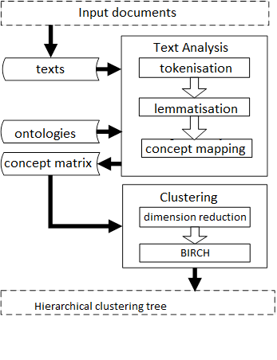
Метод зернового приращения
Стратегия зернового приращения на основе модели ранжирования

Slide 11
Метод зернового приращения
Кластерный анализ

Slide 12
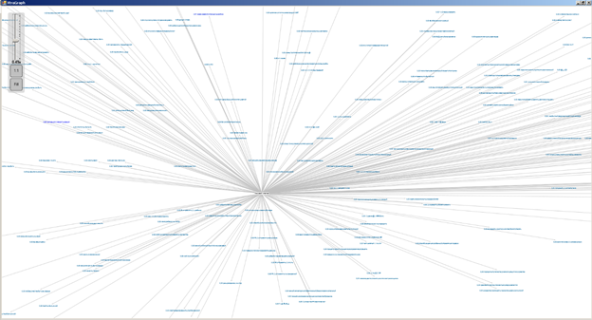
Визуализация результатов кластерного анализа
Корневой кластер находится в Центре
Ребра описывают отношения «родитель» – «поломок».
Угол bописывает близость тем
Расстояние от центра – описывает узконаправленность / специализированность ккластера.

Slide 13
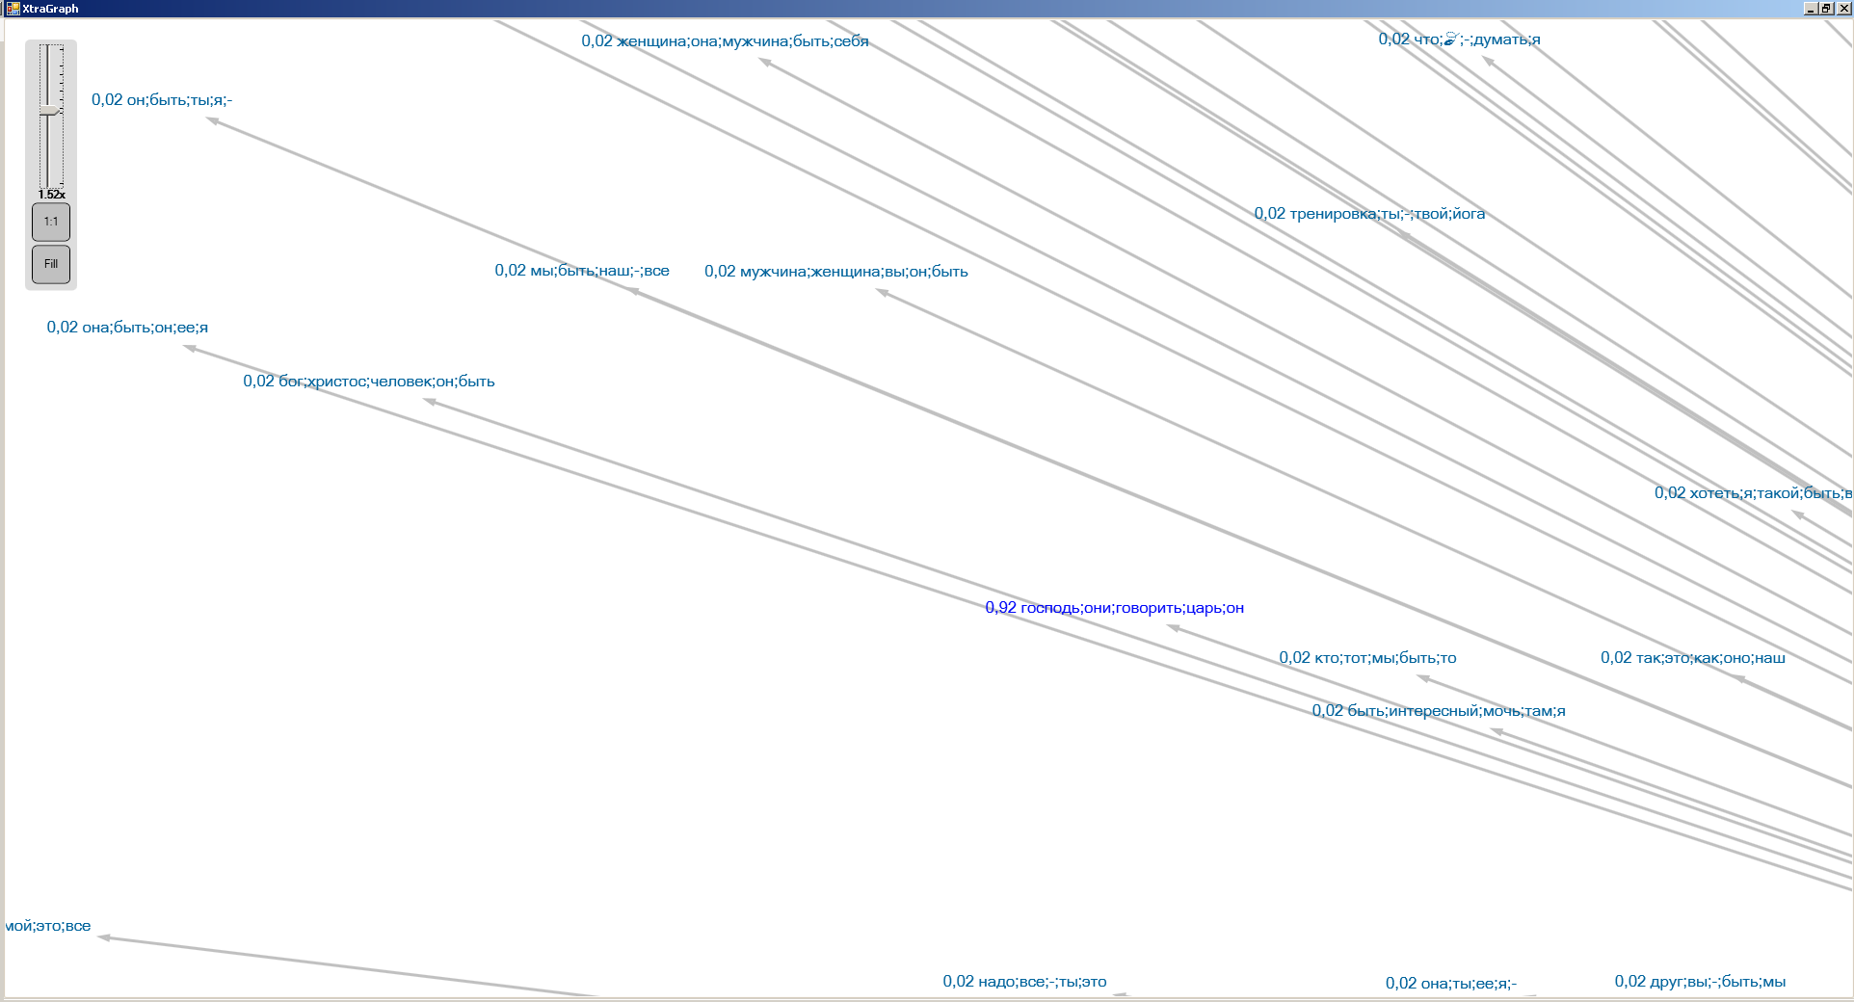
Визуализация результатов кластерного анализа

Slide 14
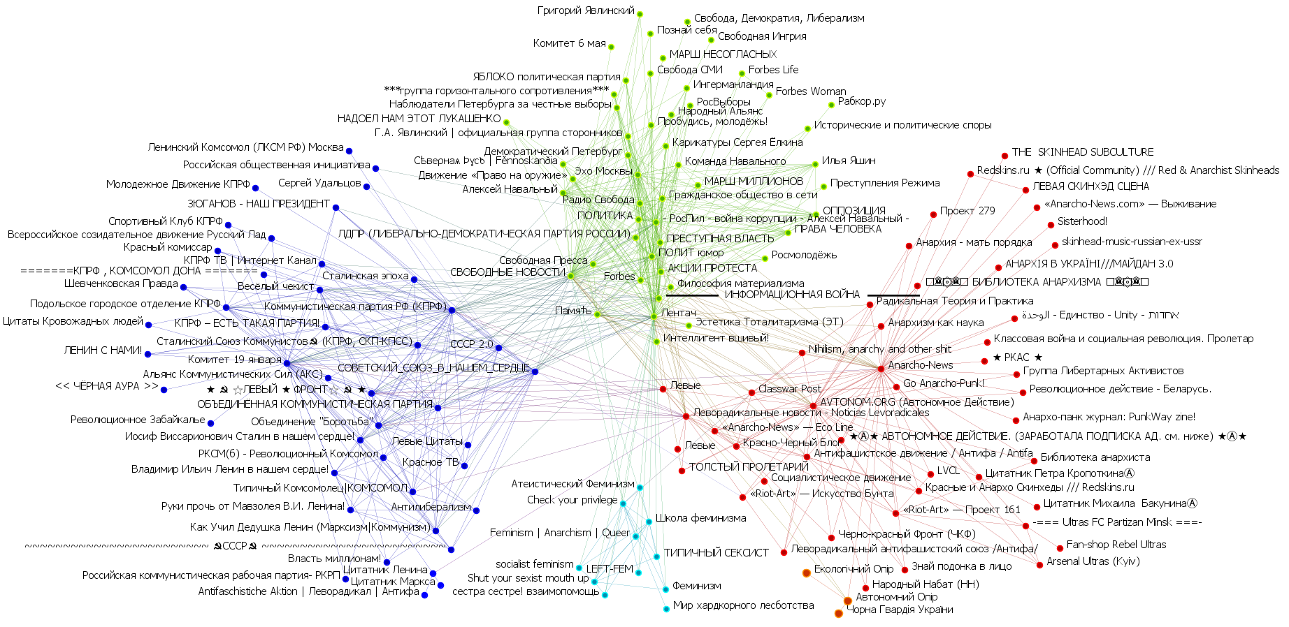
Примеры применения метода – построение политической карты
(выборы 2017)

Slide 15
COMMUNITY DETECTION

Slide 16
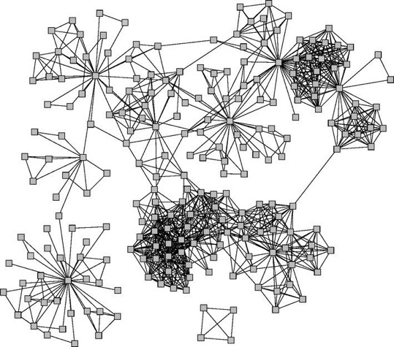
Network communities
Connected and undirected graphs

Slide 17
Network communities
What makes a community (cohesive subgroup):
Mutuality of ties. Everyone in the group has ties (edges) to one another
Compactness. Closeness or reachability of group members in small number of steps, not necessarily adjacency
Density of edges. High frequency of ties within the group
Separation. Higher frequency of ties among group members compared to non-members
Wasserman and Faust

Slide 18
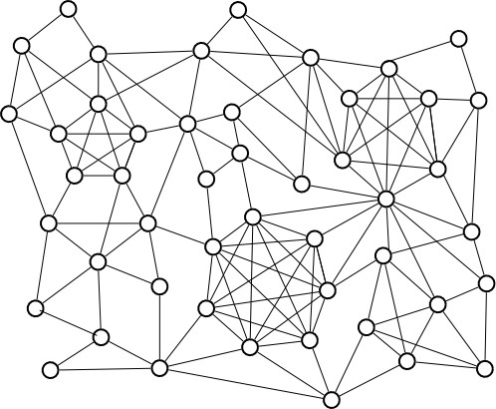
Graph cliques
A clique is a complete (fully connected) subgraph, i.e. a set of vertices where each pair of vertices is connected.
Cliques can overlap

Slide 19
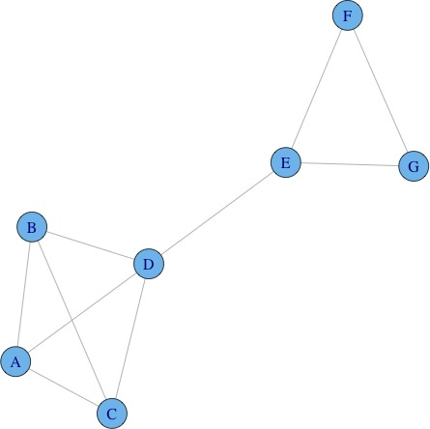
Graph cliques
A maximal clique is a clique that cannot be extended by including one more adjacent vertex (not included in larger one)
A maximum clique is a clique of the largest possible size in a given graph
Graph clique number is the size of the maximum clique

Slide 20
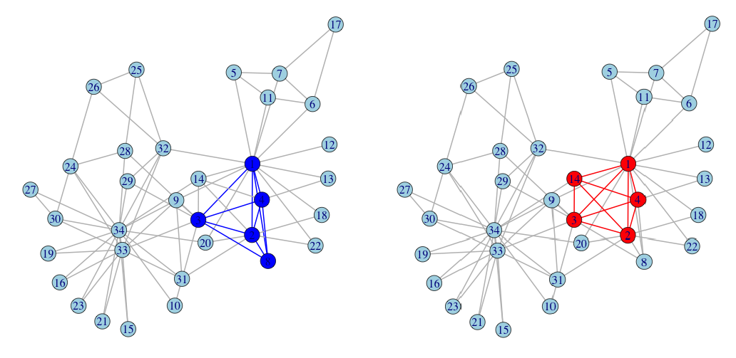
Graph cliques
Maximum cliques
Maximal cliques: Clique size: Number of cliques:
2 3 4 5
11 21 2 2
Zachary, 1977

Slide 21
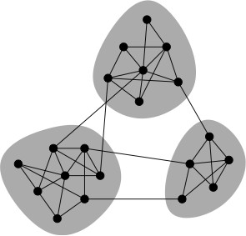
Network communities
Network communities are groups of vertices such that vertices inside the group connected with many more edges than between groups.
Community detection is an assignment of vertices to communities. Will consider non-overlapping communities, graph cuts

Slide 22
Community detection
Consider only sparse graphs m «n² Each community should be connected Combinatorial optimization problem:
optimization criterion (cut, conductance, modularity)
optimization method
Exact solution NP-hard
(bi-partition: n = n₁ + n₂, n!/(n₁!n₂!) combinations)
Solved by greedy, approximate algorithms or heuristics Recursive top-down 2-way partition, multiway partition Balanced class partition vs communities

Slide 23
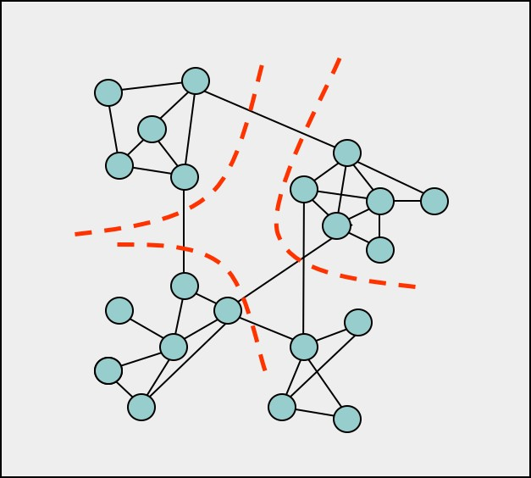
Multiway partitioning

Slide 24
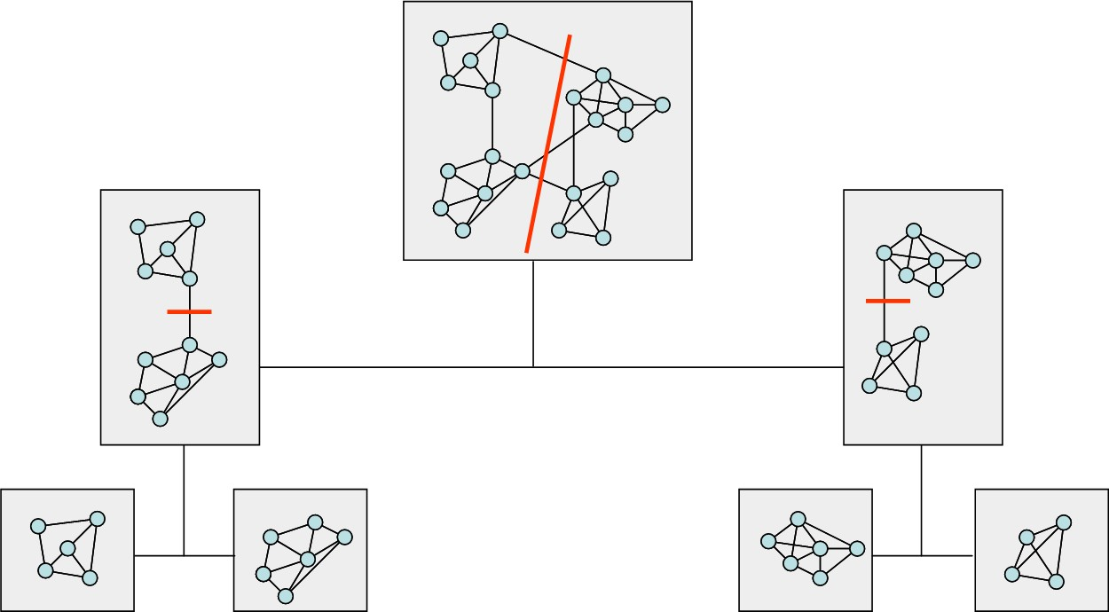
Recursive partitioning
recursive partitioning

Slide 25
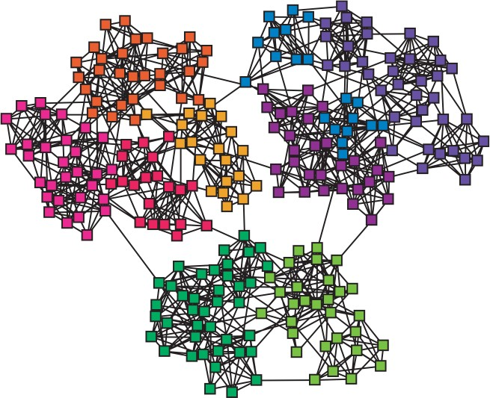
Edge betweenness
Focus on edges that connect communities.
Edge betweenness -number of shortest paths σ_{st} (e) going through edge e
Construct communities by progressively removing edges

Slide 26
Edge betweenness algorithm
Newman-Girvan, 2004
Algorithm: Edge Betweenness
Input: graph G(V,E)
Output: Dendrogram/communities
Repeat
For all e ∈ E compute edge betweenness C_{B} (e);
remove edge e_{i} with largest C_{B} (e_{i} ) ;
until edges left;
If bi-partition, then stop when graph splits in two components (check for connectedness)

Slide 27
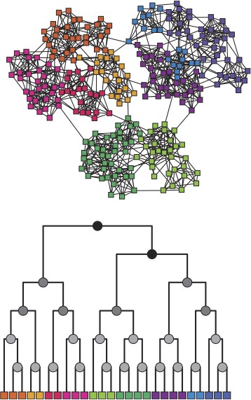
Edge betweenness Hierarchical algorithm, dendrogram

Slide 28
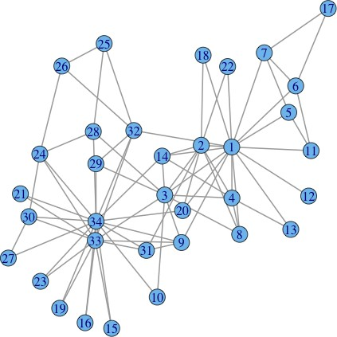
Zachary karate club

Slide 29
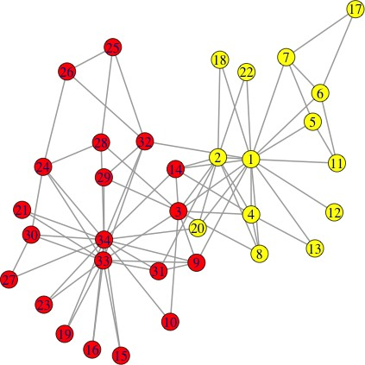
Zachary karate club

Slide 30
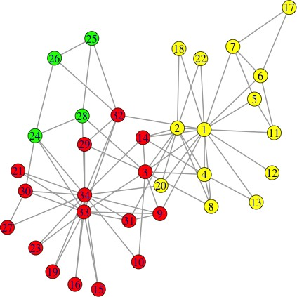
Zachary karate club

Slide 31
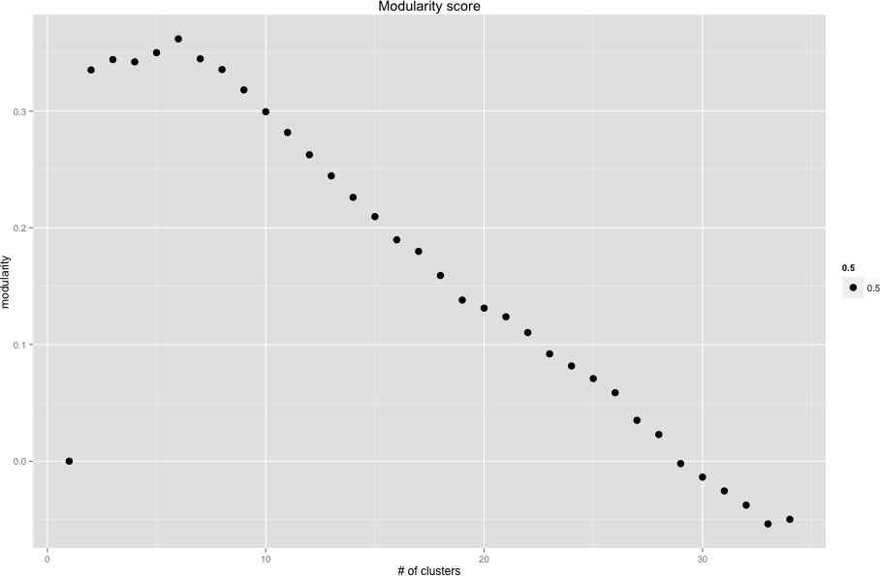
Modularity score
Edge betweenness

Slide 32
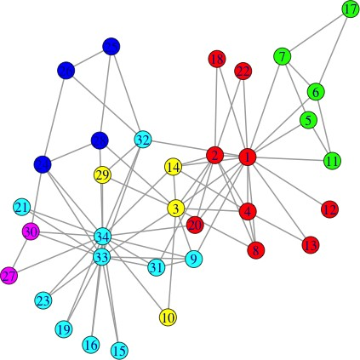
Edge betweenness
best: clusters = 6, modularity = 0.345

Slide 33
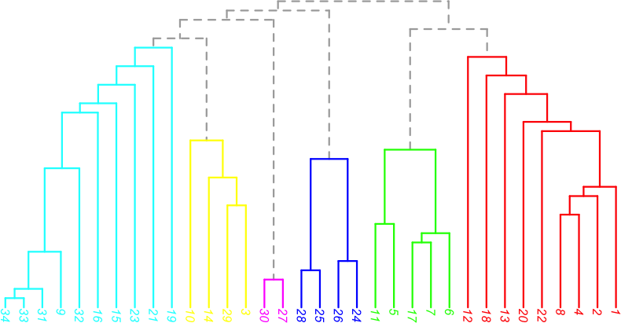

Slide 34
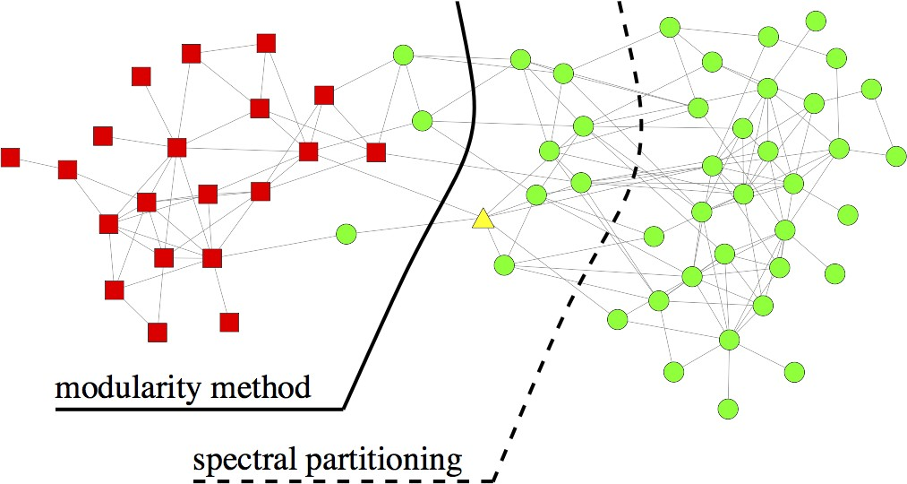
Spectral partitioning

Slide 35
Spectral modularity maximization
M. Newman, 2006
Algorithm: Spectral modularity maximization: two-way partition
Input: adjacency matrix A Output: class indicator vector s compute k = deg (A);
1 T
compute B = A − kk ;
2m
solve for maximal eigenvector Bx = λx; set s = sign(x_{max} )

Slide 36
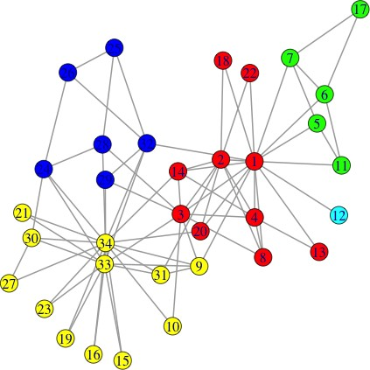
Leading eigenvector
clusters = 5, modularity = 0.437

Slide 37
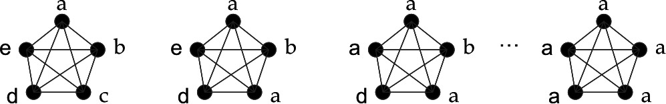
Label propagation algorithm
U.N. Raghavan, R. Albert, S. Kumara, 2007
Algorithm: Label propagation
Input: Graph G(V,E) Output: Communities Initialize labels on all nodes; Randomized node order; repeat
For every node replace its label with occurring with the highest
frequency among neighbors (ties are broken uniformly randomly);
until every node has a label that the maximum number of the neighbors have;

Slide 38
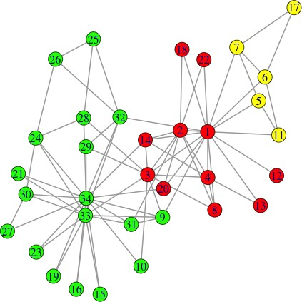
Label propagation
clusters = 3, modularity = 0.435

Slide 39
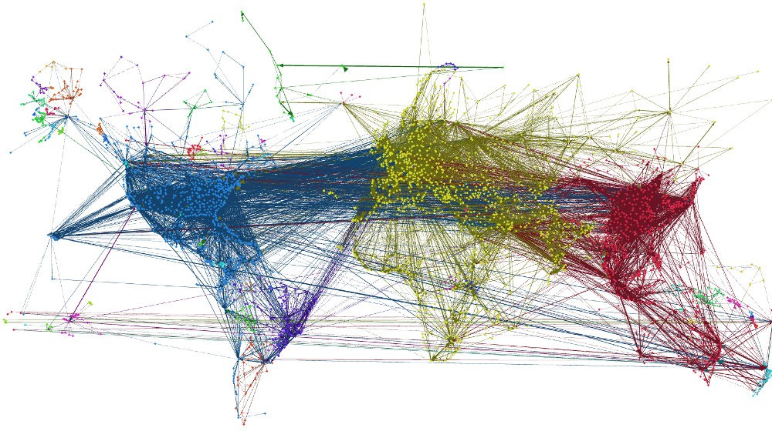
Label propagation
image from Lab41 blog

Slide 40
Fast community unfolding
V.D. Blondel, J.-L. Guillaume, R. Lambiotte, E. Lefebvre, 2008 ”The Louvain method”
Heuristic method for greedy modularity optimization Find partitions with high modularity
Multi-level (multi-resolution) hierarchical scheme Scalable
V. Blondel et.al., 2008

Slide 41
Fast community unfolding algorithm
Algorithm: Fast unfolding
Input: Graph G(V,E)
Output: Communities
Assign every node to its own community;
repeat
repeat
For every node evaluate modularity gain from removing node from
its community and placing it in the community of its neighbor;
Place node in the community maximizing modularity gain;
until no more improvement (local max of modularity); Nodes from communities merged into ”super nodes” ;
Weight on the links added up
until no more changes (max modularity);

Slide 42
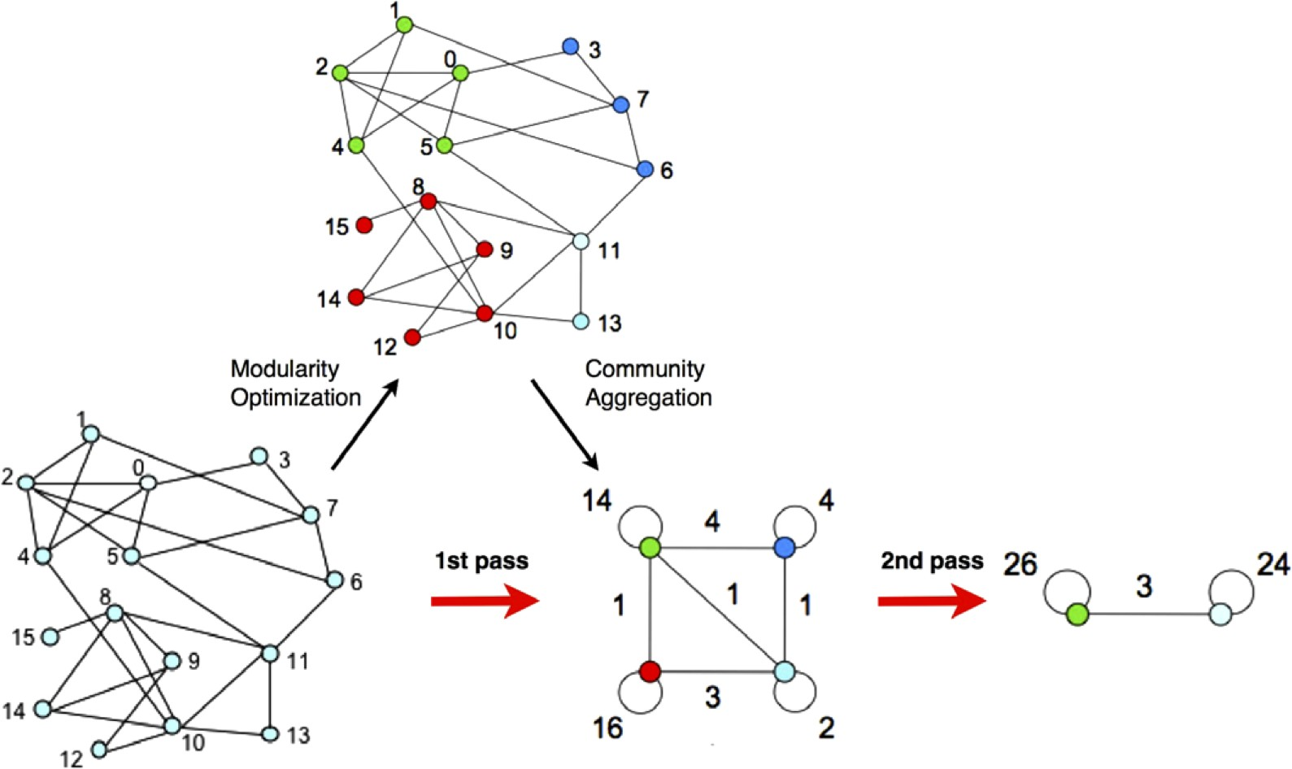
Fast community unfolding
V. Blondel et.al., 2008

Slide 43
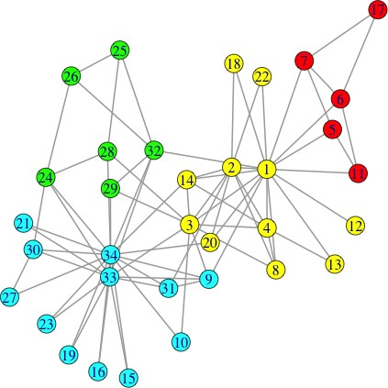
Fast community unfolding
clusters = 4, modularity = 0.445

Slide 44
Walktrap
Algorithm: Walktrap community detection
Input: Graph G(V,E)
Output: Dendrogram/communities Assign each vertex to its own community;
Compute random walk distance between adjacent vertices;
for n-1 steps do
choose two ”closest” communities and merge them ;
update distance between communities
end

Slide 45
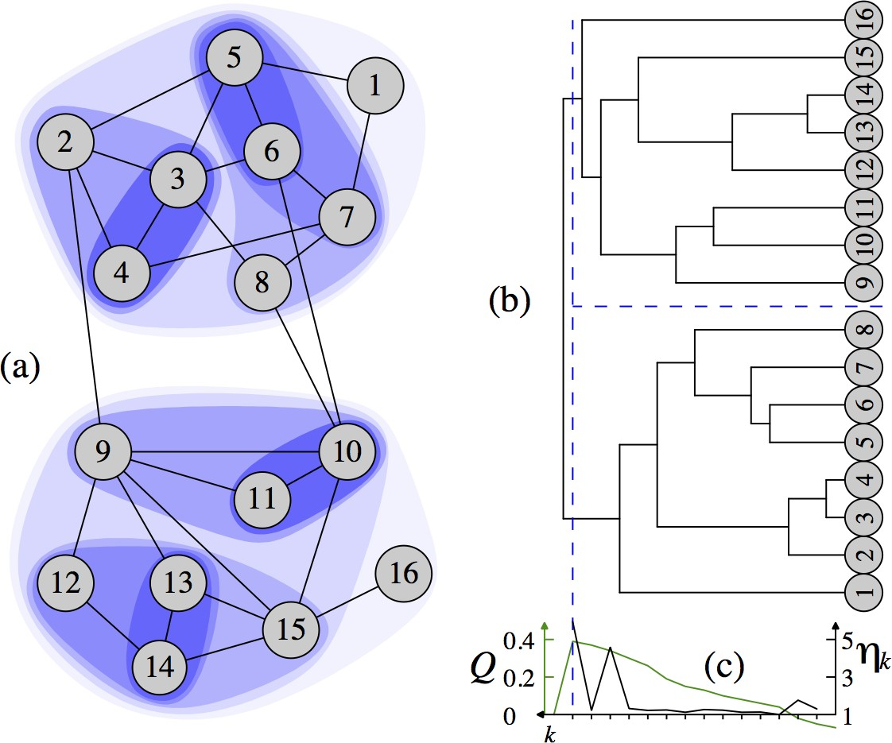
Walktrap
P. Pons and M. Latapy, 2006

Slide 46
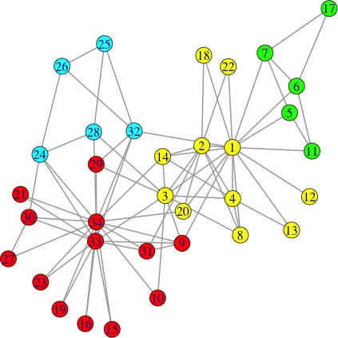
Walktrap
clusters = 4, modularity = 0.440

Slide 47
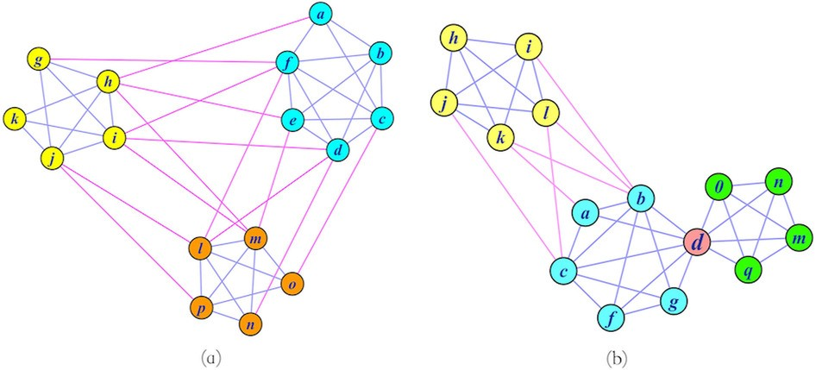
Overlapping communities
Community detection:
Graph partitioning (sparse cuts) Vertex clustering (vertex similarity)
image from W. Liu , 2014

Slide 48
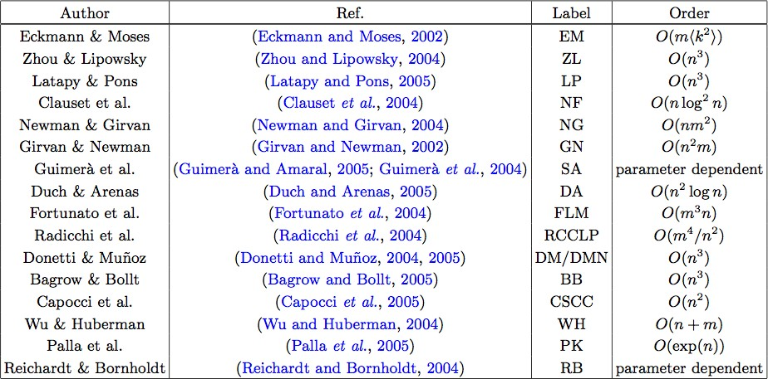
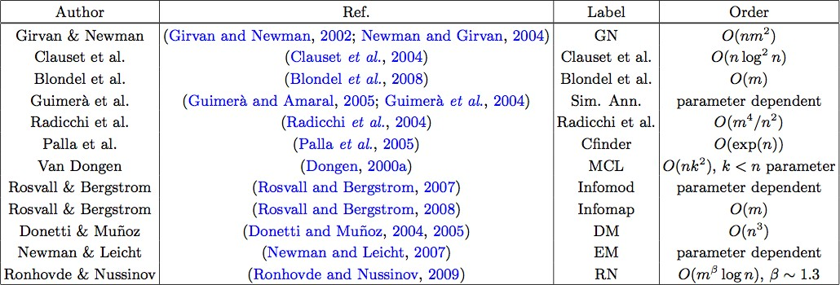
Community detection algorithms
Fortunato, 2010

Slide 49
References
S. Fortunato. Community detection in graphs, Physics Reports, Vol. 486, Iss. 35, pp 75-174, 2010
S. E. Schaeffer. Graph clustering. Computer Science Review, 1(1):2764, 2007.
Modularity and community structure in networks, M.E.J. Newman, PNAS, vol 103, no 26, pp 8577-8582, 2006
Finding and evaluating community structure in networks, M.E.J. Newman, M. Girvan, Phys. Rev E, 69, 2004
U.N. Raghavan, R. Albert, S. Kumara, Near linear time algorithm to detect community structures in large-scale networks, Phys. Rev. E 76 (3) (2007) 036106.
G. Palla, I. Derenyi, I. Farkas, T. Vicsek, Uncovering the overlapping community structure of complex networks in nature and society, Nature 435 (2005) 814?818.
P. Pons and M. Latapy, Computing communities in large networks using random walks, Journal of Graph Algorithms and Applications, 10 (2006), 191-218.
V.D. Blondel, J.-L. Guillaume, R. Lambiotte, E. Lefebvre, Fast unfolding of communities in large networks, J. Stat. Mech. P10008 (2008).

Slide 50
TEXT Classification and cLUSTERING

Slide 51
Text classification in general
f₀ f₁
…
…
…
…
…
…
… f_{n}
Representation learning
/
Feature extraction
Classification algorithm
p₀ p₁
…
… p_{c}
Text
Class label / Probability distribution
Fixed-size vector of features

Slide 52
Text label kinds
Discrete labels:
Label is known:
Binary classification: spam filtering/sentiment analysis
Multi-class classification: categorization of goods
Multi-label classification: #hashtag prediction
Label is unknown:
Text clasterization: user intent search
Continuous labels: predict a salary by CV, predict a price by a product description

Slide 53
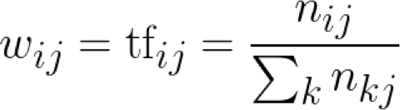
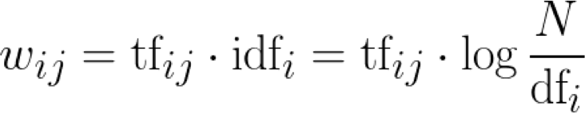
Weighting techniques for BOW
Not words are equally important for task.
So we can use weighted sum of one-hot vectors.
P(y)
Length normalization:
POS weights
TF-IDF:
Linear
w₁ w₂ 0 0 ... … … w_{N}
(~10⁵ , 1)
Weighted sum
1
0
… 0
… 0
The
0 0
1 0
… …
0 ...
… …
0 0
quick brown
0
0
…
...
… 0
fox
0 0
0 0
… …
... ...
… …
0 0
jumps over
1
0
…
...
… 0
the
0
0
…
...
… 0
dog
0
0
…
...
… 1
.
(~10⁵ ,9)

Slide 54
Dense text representation: NBOW
Instead of sparse one-hot encoding we can you use pre- trained word embeddings. It is so-called “neural bag-of- words”.
It solves three problems:
P(y)
Linear
Feature space has lower dimensionality
We utilize external data (monolingual data in case W2V, GloVe) →transfer learning
Words are treated not identically (an embedding
space has its own non-trivial structure)
(~10³ , 1)
[embedding dim.]
14.51 35.13 … … … ... 34.1
Or weighted sum (tf-idf as weights e.g.)
? Al
0.3 | 0.7 | 0.7 | 8.2 | 0.0 | 0.6 | 0.3 | 8.0 | 0.0
3.5 | 9.3 | 4.4 | 1.5 | 3.4 | 1.8 | 3.5 | 9.8 | 3.4
... | … | … | … | … | … | ... | … | …
4.1 | 3.9 | 7.8 | 5.1 | 6.1 | 3.1 | 4.1 | 5.1 | 6.1
... | … | … | … | … | … | ... | … | …
0.4 | 0.3 | 1.9 | 0.4 | 2.7 | 1.9 | 0.4 | 1.8 | 2.7
0.1 | 0.9 | 8.8 | 0.5 | 9.1 | 8.8 | 0.1 | 6.1 | 9.1
(~10³ ,9)
The
quick
brown
fox
jumps
over
the
dog
.

Slide 55
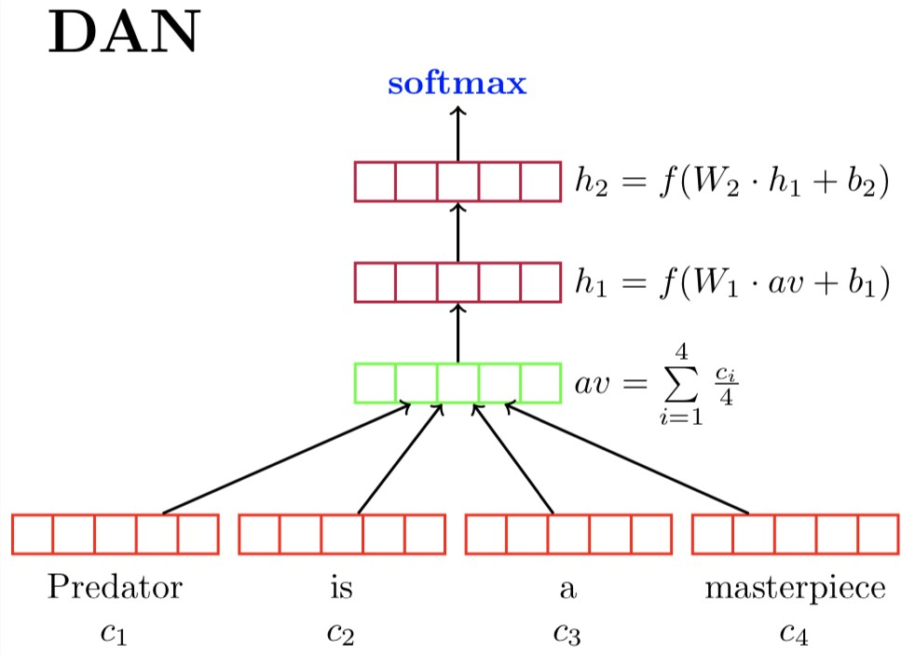
Deep averaging network
The intuition is that each layer learns a more abstract representation of the input than the previous one. Add more layers:
z_{i} = g (z_{i −1}) = f (W_{i} × z_{i −1} + b_{i} )
Word dropout: drop word tokens’ entire word embeddings from the vector average
Figure: Deep Averaging Network

Slide 56
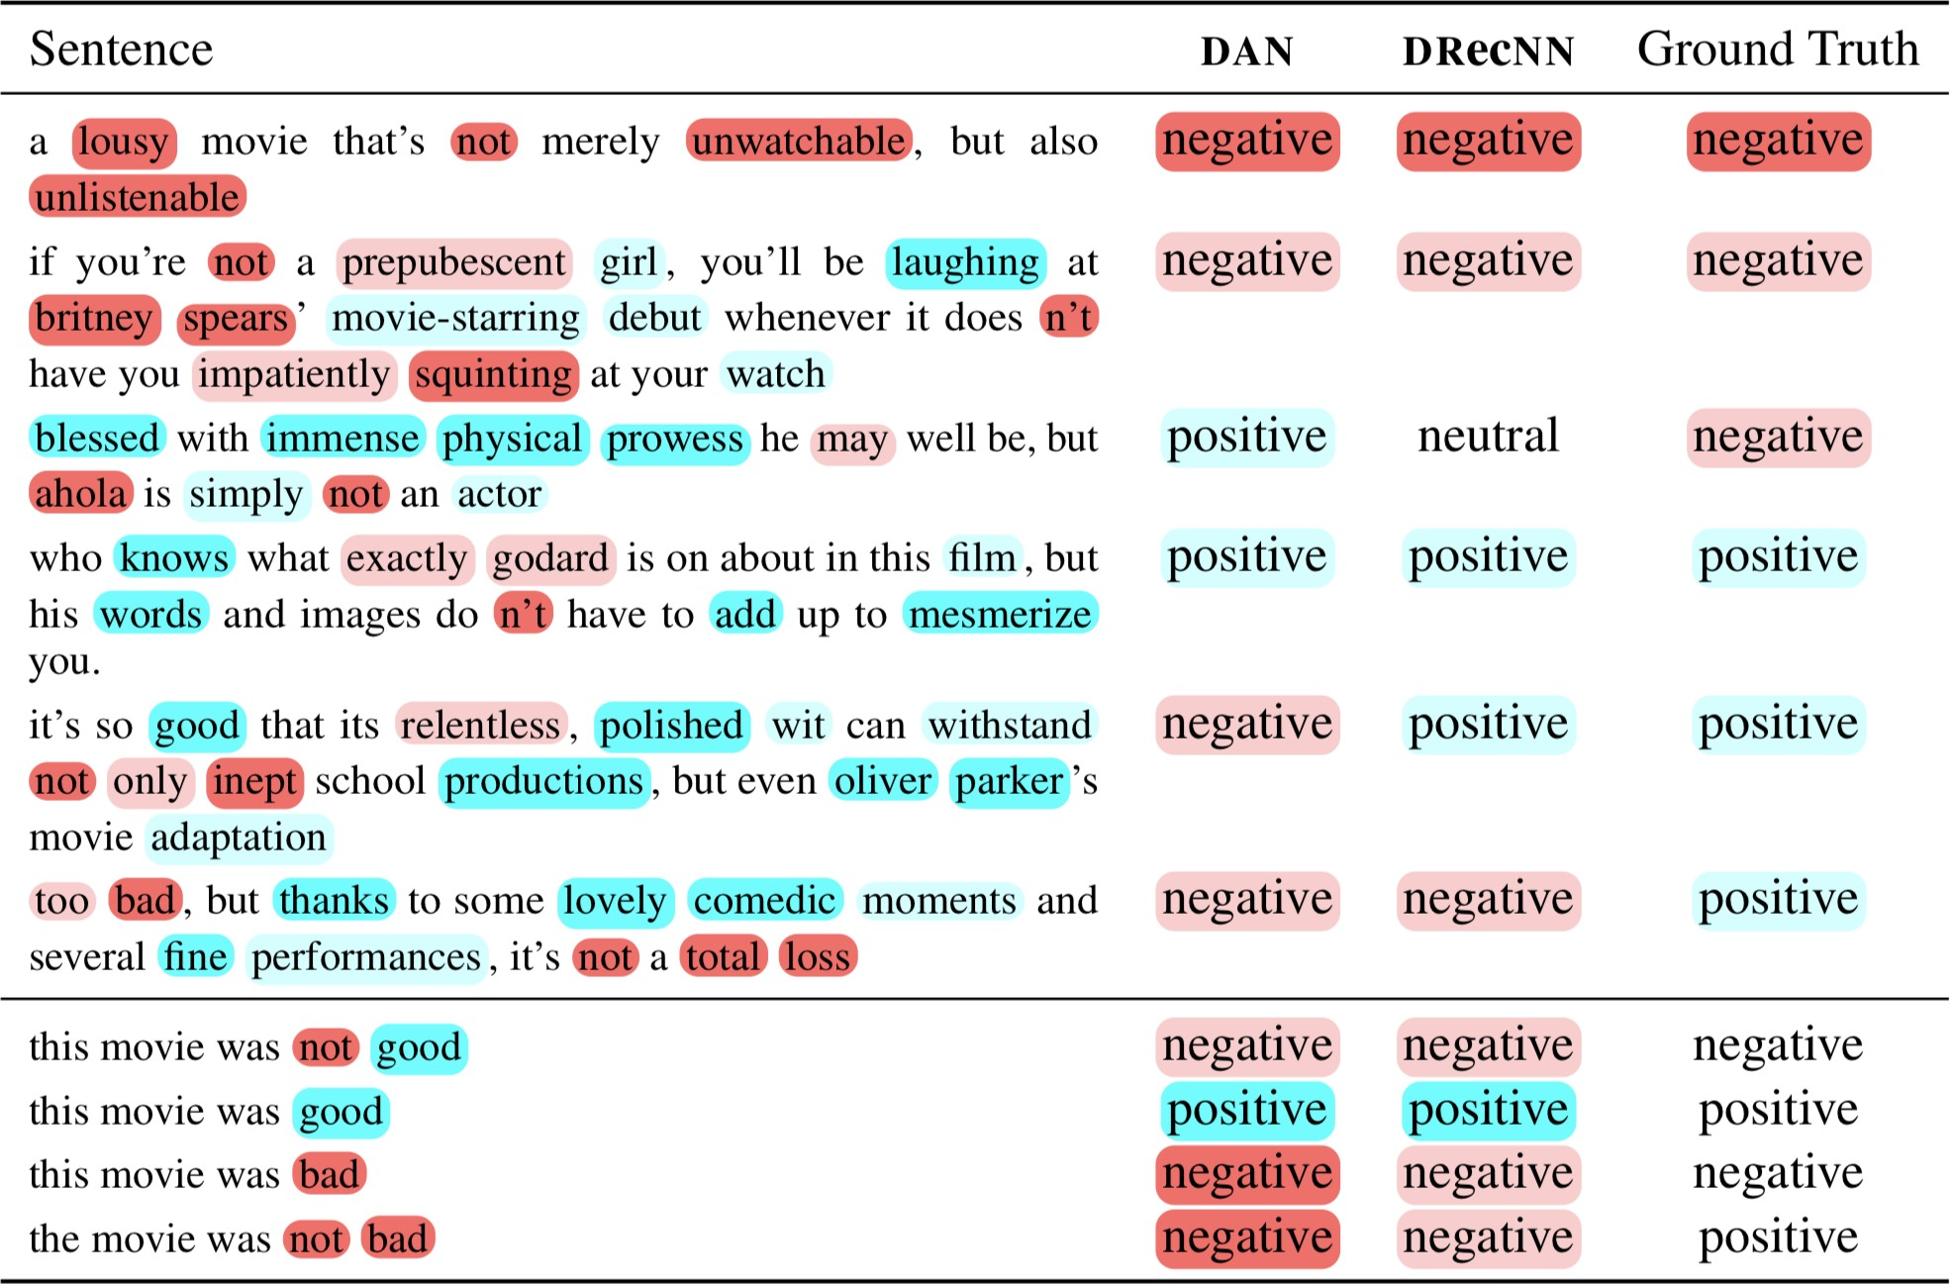
Deep averaging network
Figure: Predictions of DAN on real (top) and synthetic (bottom) sentences that contain negations and contrastive conjunctions

Slide 57
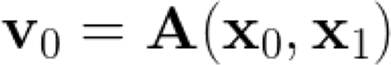
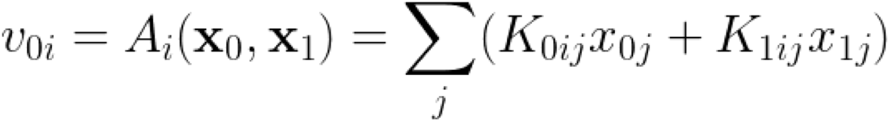
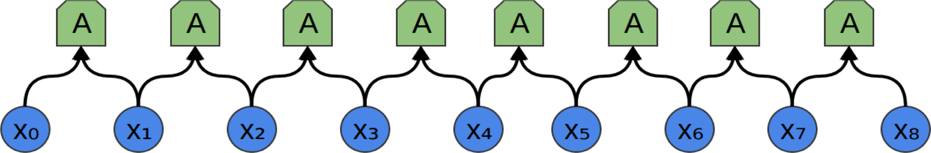
CNN for texts
P(y)
Linear
z (32,1)
Max over time pooling
v
0
v
1
v
2
v
3
v
4
v
5
v
6
v
7
(32,8)
1d-convolution 32x(100x2)
(100,9)
The
quick
brown
fox jumps
over
the
dog
.

Slide 58
Recurrent NN for text classification
In a RNN Connections between nodes form a directed graph along a sequence.
x
0
x
1
x
2
x
3
x
4
x
5
x
6
x
7
x
8
The
quick
brown
fox jumps
over
the
dog
.

Slide 59
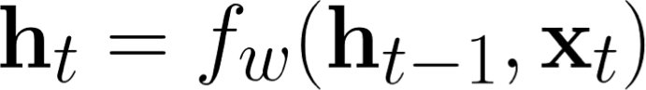

Recurrent NN for text classification
(100,9)
h | h | h | h | h | h | h | h | h
0 | 1 | 2 | 3 | 4 | 5 | 6 | 7 | 8
f | f | f | f | f | f | f | f | f
x | x | x | x | x | x | x | x | x
0 | 1 | 2 | 3 | 4 | 5 | 6 | 7 | 8
The | quick | brown | fox | jumps | over | the | dog | .
(100,9)

Slide 60

Recurrent NN for text classification
P(y)
Linear
(100,9)
h | h | h | h | h | h | h | h | h
0 | 1 | 2 | 3 | 4 | 5 | 6 | 7 | 8
f | f | f | f | f | f | f | f | f
x | x | x | x | x | x | x | x | x
0 | 1 | 2 | 3 | 4 | 5 | 6 | 7 | 8
The | quick | brown | fox | jumps | over | the | dog | .
(100,9)

Slide 61
Recurrent NN for text classification
Linear
z
Max or average over time
?
(100,9)
h | h | h | h | h | h | h | h | h
0 | 1 | 2 | 3 | 4 | 5 | 6 | 7 | 8
f | f | f | f | f | f | f | f | f
x | x | x | x | x | x | x | x | x
0 | 1 | 2 | 3 | 4 | 5 | 6 | 7 | 8
The | quick | brown | fox | jumps | over | the | dog | .
(100,9)

Slide 62

Recurrent NN for text classification
P(y)
Linear
z
Max or average over time
?
(200,9)
h | h | h | h | h | h | h | h | h
0 | 1 | 2 | 3 | 4 | 5 | 6 | 7 | 8
(100,9)
x | x | x | x | x | x | x | x | x
0 | 1 | 2 | 3 | 4 | 5 | 6 | 7 | 8
The
quick
brown
fox jumps
over
the
dog
.

Slide 63

Clustering methods

Slide 64

Word Mover’s Distance
http://proceedings.mlr.press/v37/kusnerb15.pdf

